Slide 1
Node.js
A JavaScript runtime built on Chrome’s V8 Engine
Notes:
Giới thiệu về khóa training
Các thành phần tham gia dự
Nội dung chính, lịch trình, tiêu chí và những quy định

Slide 2
Criteria & Regulations
Criteria:
1
2
3
4
5
Regulations:
1
2
3
4
5

Slide 3
Node.js – Training course
Section 2 – Day 1
How javascript works?
Trainer: kphong

Slide 4

SECTION 2 – MAIN CONTENT
INTRODUCTION ABOUT NODE.JS,
ARCHITECTURE, INSTALLATION AND USAGE
ENVIRONMENT
TERMS
EXECUTION CONTEXTS & SCOPE CHAIN
ECMASCRIPT
OVERVIEW
FEATURES & VERSIONS
FEATURES
LET & CONST
ARROW FUNCTIONS
Notes:
JavaScript thời kỳ trước sự có mặt của Node.js
Concepts, khái niệm cơ bản về Node.js
Kiến trúc tổng quan và một số chi tiết về Node.js
Cách cài đặt & sử dụng, quản lý phiên bản Node.js, quản lý gói/package/thư viện – dependencies và cách thực thi binaries của gói/package.

Slide 5

TERMS
Prototype,
Object Literal
Class & Abstract Class
Inheritance
getter, setter, static
Default parameters
Spread Syntax
Notes:
Phân tích cú pháp
Môi trường

Slide 6
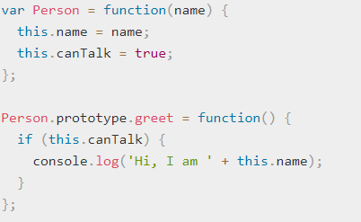
Prototype
Notes:
https://developer.mozilla.org/en-US/docs/Web/JavaScript/Reference/Global_Objects/Object/prototype
https://developer.mozilla.org/en-US/docs/Web/JavaScript/Inheritance_and_the_prototype_chain

Slide 7
Prototype
As prototype object is an object, we can attach properties and methods to the prototype object. Thus, enabling all the objects created using the constructor function to share those properties and methods.
New property can be added to the constructor function’s prototype property using either the dot notation or square bracket notation as shown below

Slide 8

Object Literal
JavaScript is designed on a simple object-based paradigm. An object is a collection of properties, and a property is an association between a name (or key) and a value. A property's value can be a function, in which case the property is known as a method. In addition to objects that are predefined in the browser, you can define your own objects. This chapter describes how to use objects, properties, functions, and methods, and how to create your own objects.
https://developer.mozilla.org/en-US/docs/Web/JavaScript/Guide/Working_with_Objects
Notes:
https://developer.mozilla.org/en-US/docs/Web/JavaScript/Guide/Working_with_Objects

Slide 9
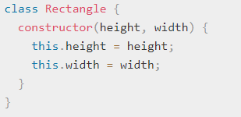
Class
Notes:
https://developer.mozilla.org/en-US/docs/Web/JavaScript/Reference/Classes

Slide 10
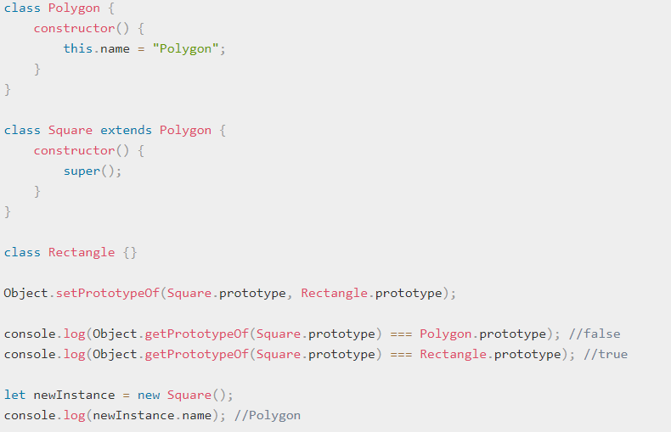
Inheritance
The extends keyword is used in class declarations or class expressions to create a class which is a child of another class
Notes:
https://developer.mozilla.org/en-US/docs/Web/JavaScript/Reference/Classes/constructor

Slide 11
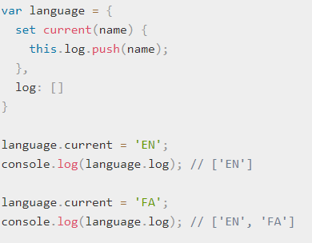
getter, setter, static
The set syntax binds an object property to a function to be called when there is an attempt to set that property.

Slide 12
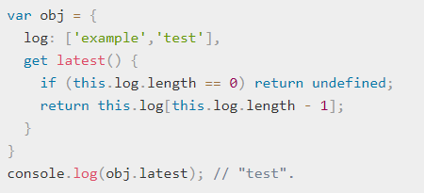
getter, setter, static
The get syntax binds an object property to a function that will be called when that property is looked up.

Slide 13
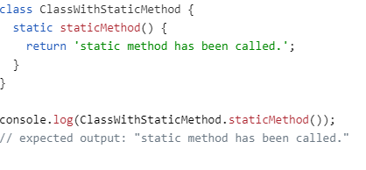
getter, setter, static
The static keyword defines a static method for a class. Static methods aren't called on instances of the class. Instead, they're called on the class itself. These are often utility functions, such as functions to create or clone objects.

Slide 14
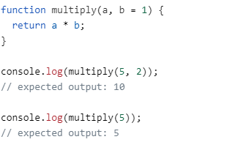
Default parameters
Default function parameters allow named parameters to be initialized with default values if no value or undefined is passed.

Slide 15
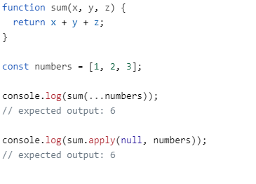
Spread syntax
Spread syntax allows an iterable such as an array expression or string to be expanded in places where zero or more arguments (for function calls) or elements (for array literals) are expected, or an object expression to be expanded in places where zero or more key-value pairs (for object literals) are expected.
Notes:
https://developer.mozilla.org/en-US/docs/Web/JavaScript/Reference/Operators/Spread_syntax

Slide 16
Thank you!

